Slide 1
Science, Technology and Democracy Daniel Lee Kleinman, editor
Chapter 2
Town Meetings and Technology
Consensus Conferences as Democratic Participation
Richard E. Sclove

Slide 2
In democracy, policy decisions effect all citizens.
Yet, these policies are framed by: business, military and university representatives.
The argument is that non experts are ill equipped to comment on complex technical matters. (Unimaginable that citizens who can’t even program their VCR(DVD) player can contribute)

Slide 3
Technology Assessment Agencies
Consensus Conference Format
Engages a much wider range of people, holds the potential to build a broader constituency familiar with and supportive of technology assessment.
Both the forum and subsequent judgment, in a formal report, become a focus of national attention, in Denmark – usually before Parliament.
These judgments are non binding – just give a sense to legislator of where the people stand on some technological issues.

Slide 4
Danish Board of Technology has organized more than twenty consensus conferences.
Genetic engineering
Educational technology,
Food irradiation, air pollution
Human infertility
Sustainable agriculture
Telecommuting and the future of private automobiles.

Slide 5
Consensus conference is crucial to limiting the negative and often unintended consequences that can result when technologies are deployed without widespread social consideration.

Slide 6
Framing an Issue
The Danish Board of Technology
To organize a consensus conference it first:
Selects a salient topic. (Broader than assessing toxicity of a single chemical, and narrower than formulating national strategy)
Board select a well balanced steering committee. (To oversee the organization of the conference)

Slide 7
Board advertises in local newspapers for volunteer lay participants. (Candidates must sent a one-page letter describing their backgrounds and reasons for wanting to participate)
A skilled facilitator helps lay participants discuss background paper (commissioned by the board and screened by the steering committee.)

Slide 8
The group then formulates questions, suggests addition addressed during a public forum.
The Board goes on to assemble an expert panel.
The lay group meets for a second weekend, to discuss background readings, refine questions, etc.
The Board finalizes the expert panel and asks its members to prepare oral and written responses.
In the concluding public forum, a four day event, facilitator brings together experts with the media, MPs and interested Danish citizens.

Slide 9
Every expert speaks 20 to 30 minutes.
Addresses follow up questions.
And questions from the audience.
Afterwards the ley group retires to discuss what it heard.
On the next day they cross examine the expert panel.

Slide 10
Then they are politely dismissed.
Lay group prepares a report summarizing points of agreement and those which are in disagreement.
On the fifth day expert panel me correct their reports.
In the end the lay group presents its report at a national press conference.

Slide 11
1992 Danish Conference on genetically engineered animals shows a perspective that is neutral, neither pro or anti technology.
Patenting animals could deepen the risk of their being treated purely as objects.
It would lead to objectification of people.
Genetically altered animals into the wild – could create a domination or out-competing wild species.
No problem if fenced.

Slide 12
Can these Consensus Conferences be held in Kosovo?
What topics would be selected as relevant public policy issues?
Examples:
Ban gender selection babies during pregnancy of expectant mothers?
Health?
Education – Finland's experiences? Pros and cons?
Foreign Investments in large projects, like in Brezovica, Trepca, Rugova?
Subsidize trade, versus production in Kosovo? Agriculture?

Slide 13
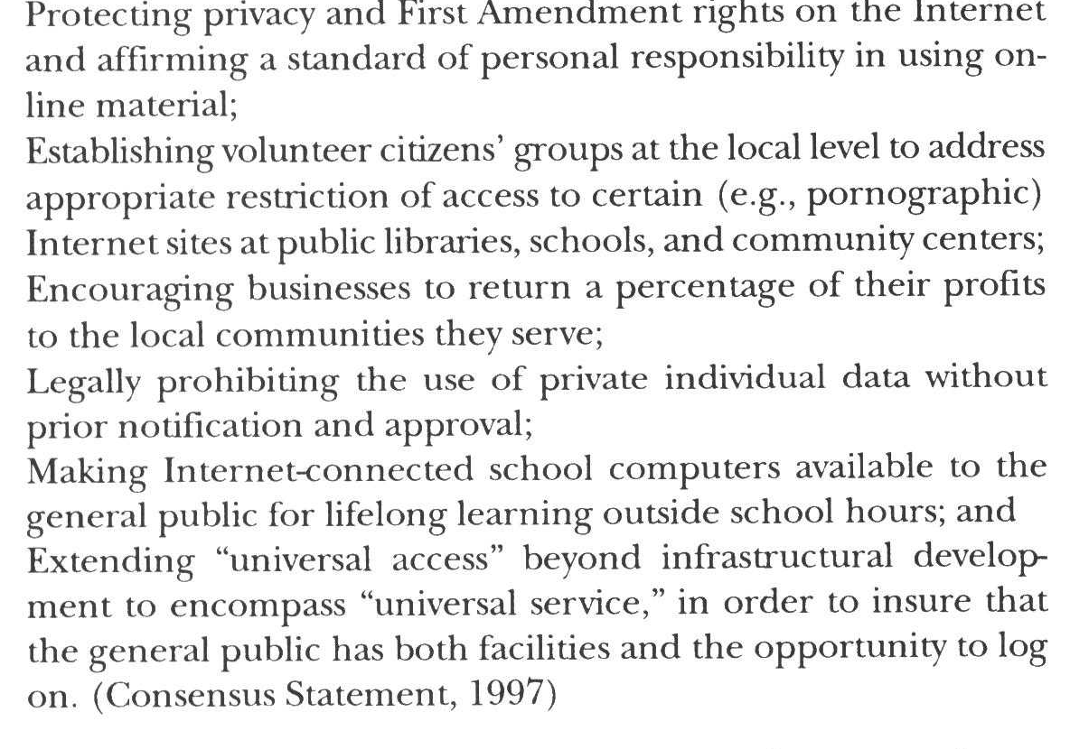

Slide 14
Can digital technologies threaten democracy by creating information cocoons? Cédric Gossart1
Explore the role that information and communication technologies (ICTs) can play in the emergence of public problems.
Indeed, if these technologies can support democratic claims, they can also hamper their expression.
The transformation of a private claim into a public problem is a key step in the process leading to its integration in the political agenda.

Slide 15
A public problem can be defined as
“the transformation of some social fact into a public issue and/or state intervention (…) if it has been constructed by the voluntary action of various operators” (Neveu 1999).

Slide 16
For example,
the carrying capacity of public arenas as well as the “degree of dramatisation” reached to capture public attention have a strong influence on the selection of public problems (Hilgartner and Bosk 1988)

Slide 17
The media play a critical role in this process, since they can offer efficient channels of communication to name, blame, or claim.
The profusion of information on the Internet can cause information overload which leads people to develop technological and psychological protection mechanisms.

Slide 18
4. Accounting for information closure
Information closure corresponds to the “reduction of the capacity of the agent to search, locate, sort out, filter, and select information that might be useful and relevant for him/her”

